Slide 1
Latex Tutorial
Jackson Benning

Slide 2
Overview of today
What is LaTeX?
Example 1: Basic Document
Where to use LaTeX/Setup
Basics of LaTeX
Example 2: Lab Report
Example 3: Resume
Resources

Slide 3
What is latex?
A typesetting language, think a programming language to make documents beautiful
It is built for anything mathematical related (research papers especially)
Microsoft word is built using “what you see is what you get” mantra of formatted text
LaTeX is written in plain text with markup tagging
Why use LaTeX? Have you ever had the feeling when using word or docs that you just couldn’t get something to be in the exact right place? With LaTeX you can.

Slide 4
Example 1: Basic document

Slide 5
Where to use latex? And setup
Most university computers have LaTeX installed already
Can download a package for Windows, Mac, or Unix
Main packages are: MacTex(for Mac) and MikTex(for Windows)
Main places to use: Overleaf, Normal text editor with built in viewing

Slide 6
Basics of latex: important chars
There are some important characters and a characteristic of LaTeX
Characters:
“\”: Starts a typesetting command
“{}”: Any arguments are put inside the curly braces
‘\\”: Newline without a new paragraph
“%”: Used to start a comment, everything after on the same line is treated as such
Characteristic:
LaTeX wraps adjacent lines as if they were part of a same paragraph. Insert extra return for a new paragraph

Slide 7
Basics of latex: document class
Document classes is how LaTeX interprets a particular document
Main available types are:
Article: articles in scientific journals, short reports, program documentation
Report: longer reports containing several chapters, small books, thesis work
Slides/beamer: for presentations
Starting a new document:
\documentclass{article}
\begin{document}
%your writing here
\end{document}

Slide 8
Basics of latex: Sectioning
Sectioning is to create different sections and subsections in your documents.
\section{name of section}: creates a section with the specific name, is numbered
\subsection{name of subsection}: creates a subsection under the larger section
\subsubsection{name of subsubsection}: I think you get the idea
\paragraph{name of paragraph}: like section but not numbered
\subparagraph{name of subparagraph}: like paragraph but indented, goes under a paragraph

Slide 9
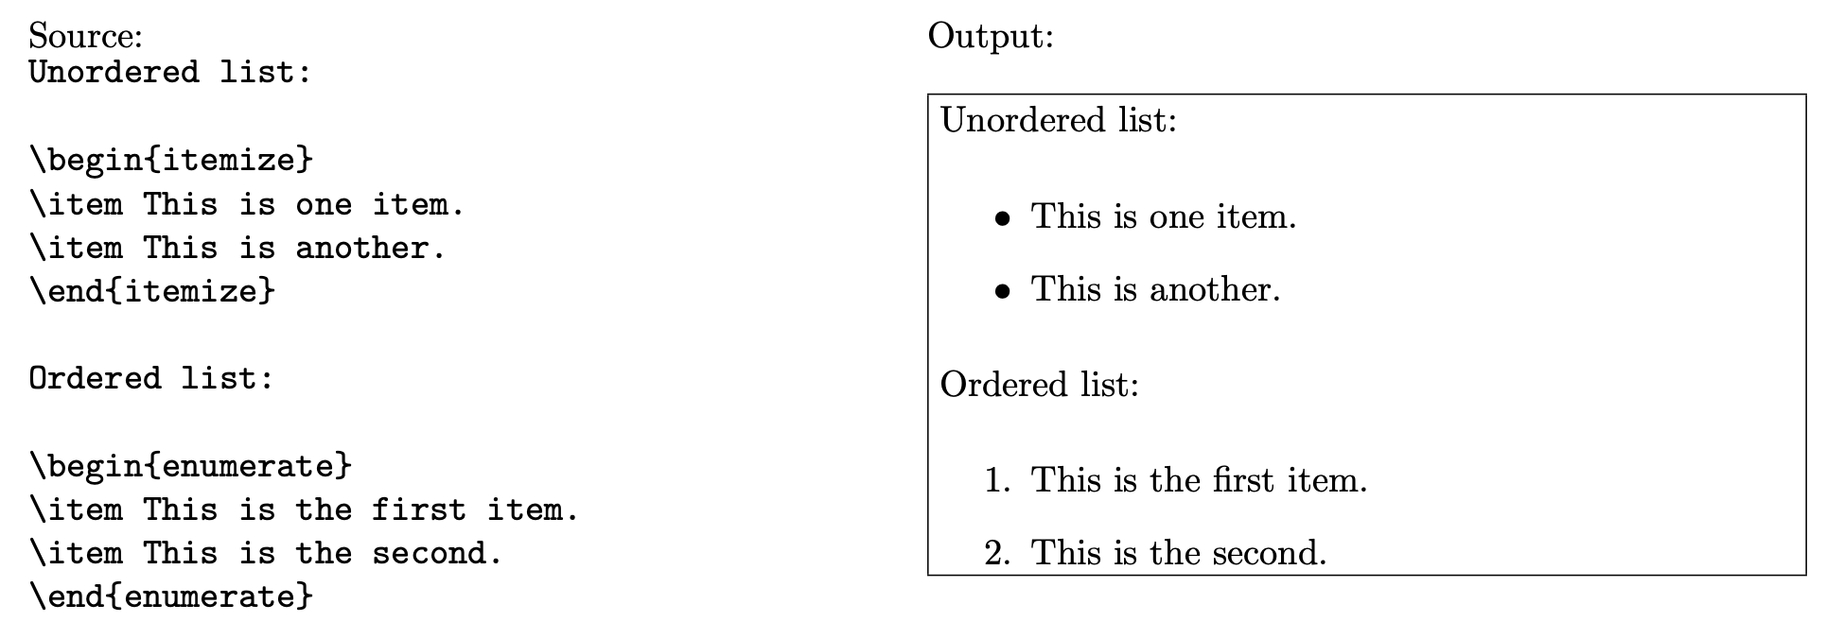
Basics of Latex: lists, tables, references
Using the tabular environment(see environments next) can create very easy tables as shown below.
Can create ordered or unordered lists or sublists as shown on the right.
References/labels:
Can refer to section numbers, figures, equations, etc.
For sections, after the section command, on the next line put \label{labelname}. Then can refer to the section using \ref{labelname} anywhere.

Slide 10
Basics of latex: Packages
Just like any other programming language, people can build packages that give the programming language to do certain things and other people can download said packages.
Most packages are already installed by default
To use them, do a \usepackage{packagename} before you begin your document

Slide 11
Advanced Latex: circuit diagrams/syntax highlighting
Include this because most of us here are EE/Compe majors
Can use the circuitikz package to create circuit diagrams
Can use the listings package to use syntax highlighting for various languages that you include code snippets in your document.

Slide 12
Examples

Slide 13
Resources
overleaf.com: has good tutorials on the basics of LaTeX
tex.stackexchange.com: stack exchange specifically for LaTeX issues
https://latex-tutorial.com/: Good basic LaTeX tutorial

